Slide 1
Clean Code
@vking34

Slide 2
Outline
Clean Code
Why Clean Code?
What is Clean Code?
Objectives
Cause of Code Smell
How to write Clean Code
Principles
Practices
Conventions
Tips

Slide 3

Is she pretty?

Slide 4

Is it clean, neat?

Slide 5
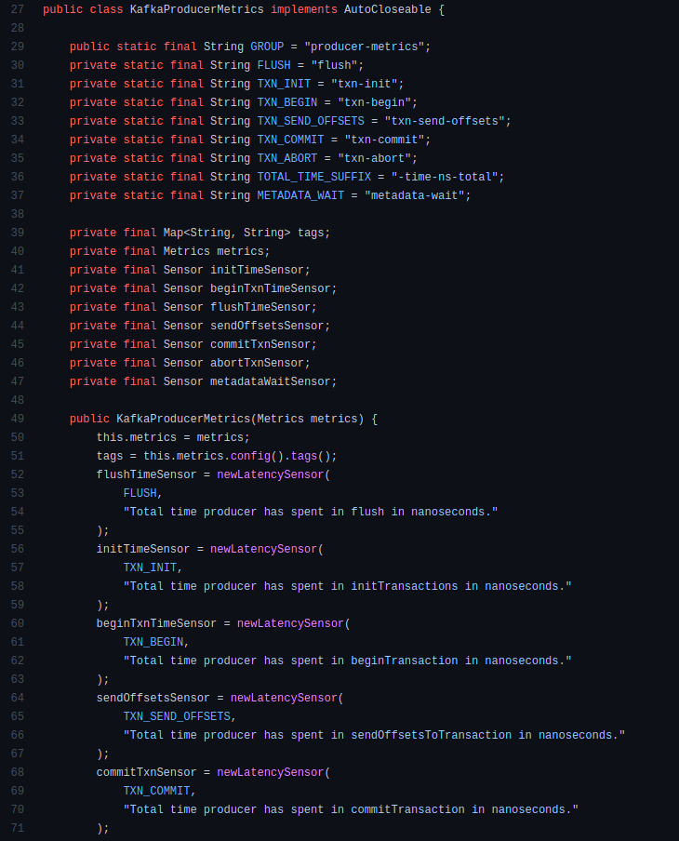
Is this clean?

Slide 6
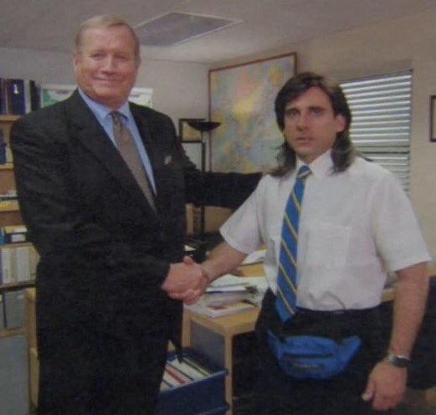
Congrats! You can write clean code! 🥳

Slide 7
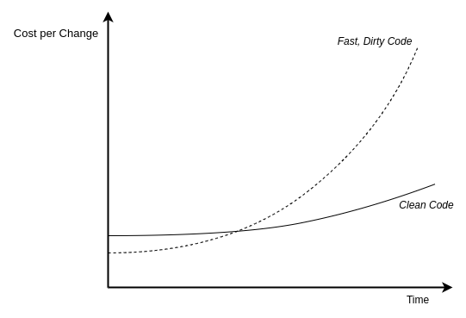
Why Clean Code?
Software Development Problems:
Slow to market
Buggy
“If you think good architecture is expensive, try bad architecture”
- Brian Foote and Joseph Yoder

Slide 8
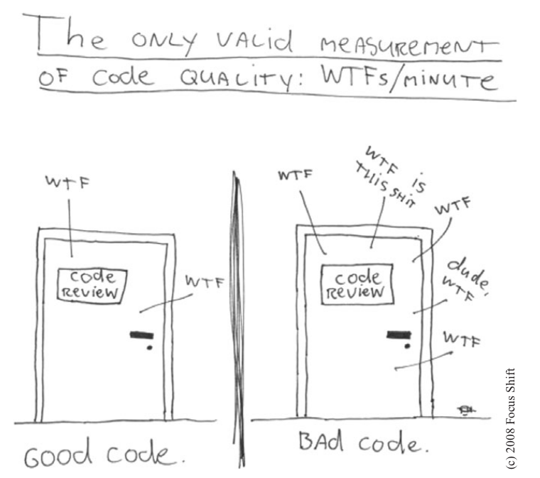
What is Clean Code?
Clean code is code that very easy to understand and change

Slide 9
Objectives/Mindset
Fourable:
Readable
Maintainable
Testable
Scalable
Objectives: same to clean architect “to minimize the human resources required to build and maintain the required system”

Slide 10
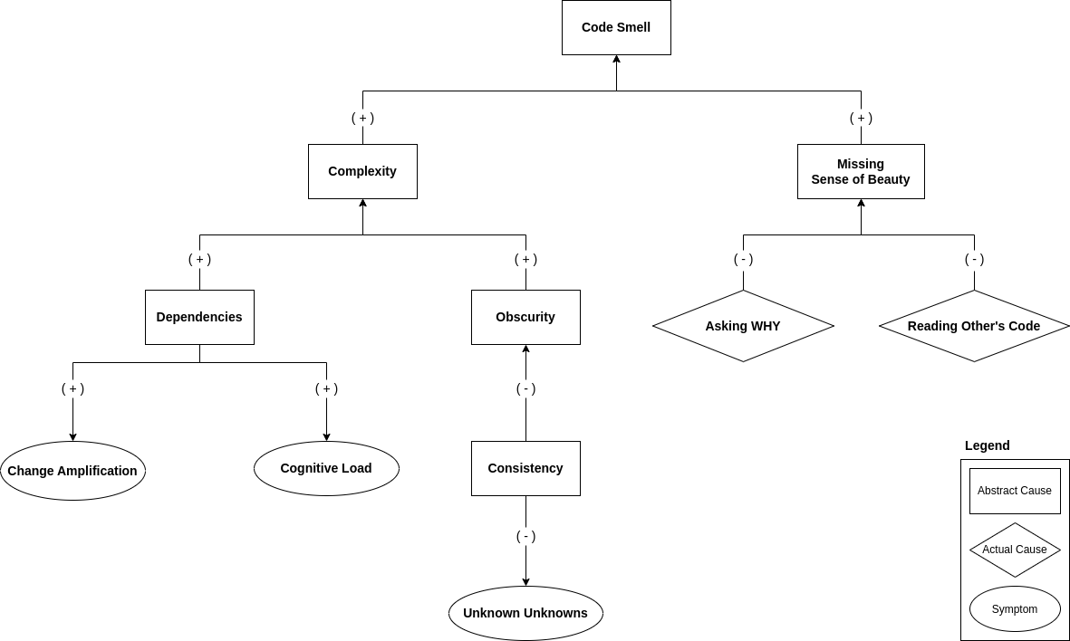
Causes of Code Smell

Slide 11
How To Write Clean Code
Abstract Ways:
Easy to understand: Naming, Conventions, Format, Code Review, Static Scanning, …
Easy to change: Principles, Design Patterns, Unit Test, Refactoring, …
Practice Ways:
Read → Got sense of beauty
Codes of others (Distinguish Clean vs Smell)
Books (Tech & Non-Tech)
Be Disciplined
Think of the principles, convention first
Practices
Fix symptoms → Know complexity
Refactor frequently
Pair programming

Slide 12
Principles
KISS: Break down the problem into small enough or understandable enough pieces
SOLID:
Single Responsibility Principle
Open-Closed Principle
Liskov Substitution Principle
Interface Segregation Principle
Dependency Inversion Principle
“If the Open-Closed Principle states the goal of OO architecture, the Dependency Inversion Principle states the primary mechanism”
Notes:
Class organization
Begin with a list of vars
Firstly, public static constants
Private static vars
Private vars
Public methods after that
Private methods

Slide 13
Practices

Slide 14
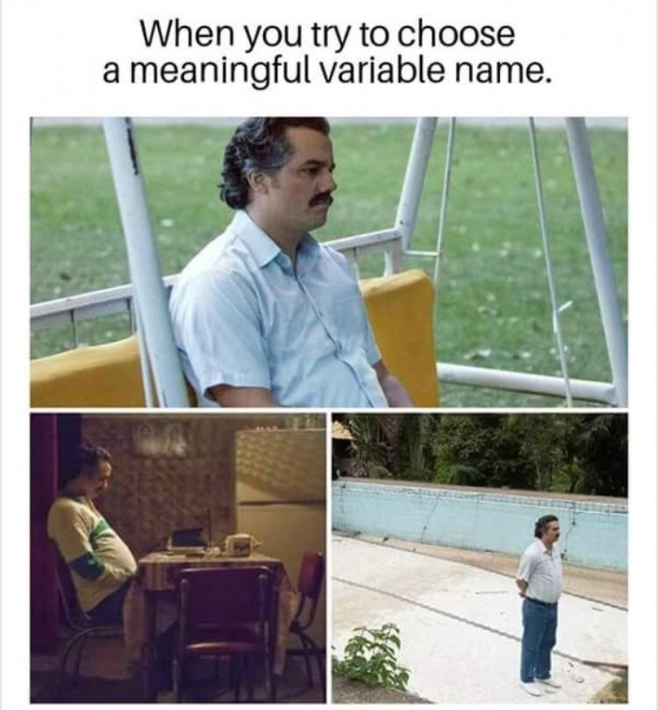


Naming Things
“There are only two hard things in Computer Science: cache invalidation and naming things” - Phil Karlton
Use names that reveal intent
boolean scope = checkScope(); boolean isScope = checkScope();
Make meaningful distinctions
Use pronounceable names
Don't use prefix to the name of container
Consistent Spelling
Notes:
Use pronounceable names
Human brain is naturally conditioned to simply gloss and skip anything that cannot be pronounced
Easy to search

Slide 15
Function
Top to Bottom Rule, Tell a story
Do one thing, SRP
Have no side effects
Command Query Separation
Keep it small
< 40 lines
Don’t repeat yourself
Easy to read
Easy to maintain
Easy to test
Avoid duplication

Slide 16
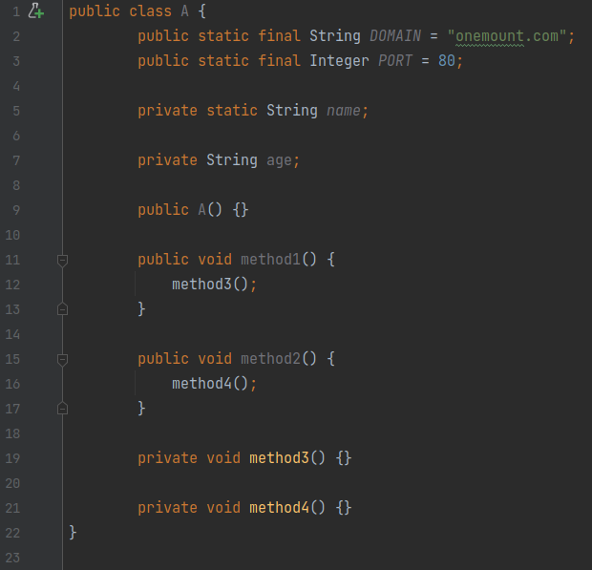
Class
Keep it small
Single Responsibility Principle
To find out if class has too much responsibility is how it is named
Open-Closed Principle - Organizing for Change
An existing class A is used to generate SQL select statement
Requirement: Generating SQL update statement
Approach: Creating a subclass B of class A
Notes:
Class organization
Begin with a list of vars
Firstly, public static constants
Private static vars
Private vars
Public methods after that
Private methods

Slide 17
Error Handling
Write try-catch-final statement first
Try blocks should be treated like transactions
Catch blocks leaves your code in a consistent state
Provide context with exceptions, add error messages:
Type of failure
Where failed
Why it did
Checked Exception vs Unchecked exception
Centralized Handling
 | Checked Exception | Unchecked exception
Definition | Checked at compile time. Represent errors outside the control of the program. If some code within a method throws a checked exception, then the method must either handle the exception or it must specify the exception using the throws keyword | Unchecked at compile time. Reflect errors inside the program logic Don’t have to declare unchecked exceptions in a method with throws keyword
Pros | Remind of handling exceptions | Preserve encapsulation Low Cost
Cons | Violate Open/Closed Principle Break encapsulation | Forget to handle exceptions
When to use | Building a critical library | Building general, robust apps

Slide 18
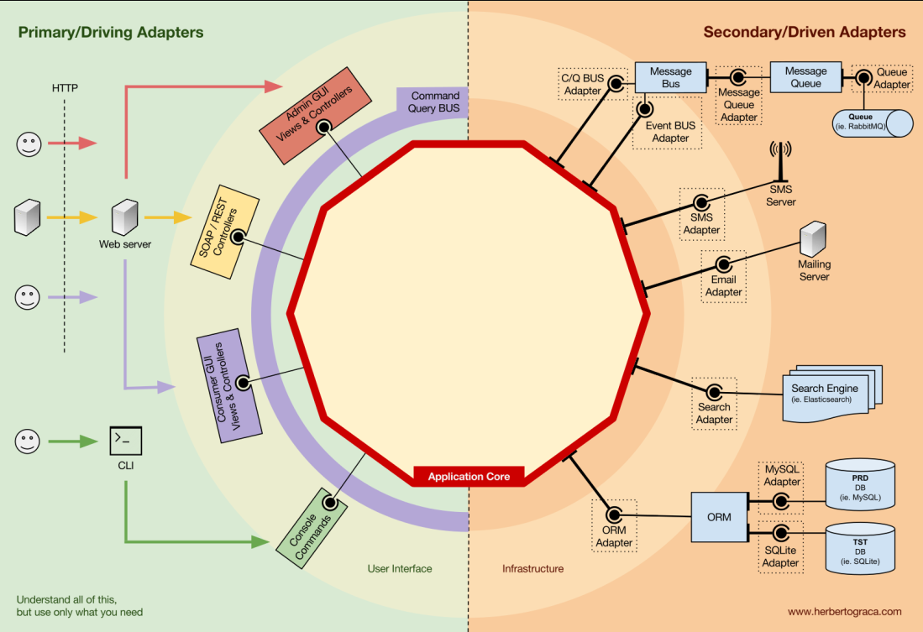
Boundary
Boundaries are points within your code where it meets others’ code. A boundary is an unpredictable area.
Avoid passing a third party object around within your own system
Do not return a function from it or accept it as an argument to your public APIs
Buffer code boundaries using adapters
Limiting dependency on external software
Future maintenance will be easier
Write tests that explore your understanding of such codes based on its intended usage (learning tests)

Slide 19
Concurrency
Limitations:
Does not always improve the performance of a system
A concurrent algorithm might have a design different from what you would have gotten with a single-threaded system since the what and when of the code has been decoupled
Limit the scope of shared data
Instead of sharing data, a better alternative is to make copies of the object and treat it as read-only
Threads should be as independent as possible
Keep synchronized sections small
Common mistake: Make critical sections very large to accommodate the synchronized statement. This will only degrade the performance
Writing correct shutdown code
Deadlock

Slide 20
Unit Tests
Understand the logic, the intent of function
Unit Test is very important → Testable → Reliability
If it is hard to test, the code might not clean
References:
Unit Testing: Principles, Practices, and Patterns: https://libgen.rocks/ads.php?md5=47f31e16745540e040bfd0688148af9c

Slide 21
Comment & Format
Comment:
80% self explain → no needs to comment
20% related to algorithms, bla bla, … → need to comment
Format:
Helpful to collab

Slide 22
Refactor
Techniques:
Composing Methods
Moving features between objects
Organizing Data
Dealing with generalization
Best Practices:
3 in-depth classes
10 files
Unit tests

Slide 23
References + Bonus
2 Hard Things: https://martinfowler.com/bliki/TwoHardThings.html
Quotes: https://quotesondesign.com/
Principles:
SOLID: https://www.freecodecamp.org/news/solid-principles-explained-in-plain-english/
KISS: https://people.apache.org/~fhanik/kiss.html
Books:
Library of contraband books: https://libgen.li/
Best tips and tricks in the world of Clean Coding: https://libgen.rocks/ads.php?md5=481473f6104d2f187dfcc11c340ca4f3
Clean Code: https://libgen.rocks/ads.php?md5=838cc6ac8cb0d8ddb98fdb1ae0c8a443
Unit Testing: Principles, Practices, and Patterns: https://libgen.rocks/ads.php?md5=47f31e16745540e040bfd0688148af9c
Talks:
https://www.youtube.com/watch?v=YtQGQ9Eg0Lo
https://www.youtube.com/watch?v=UjhX2sVf0eg
https://www.youtube.com/watch?v=c40HPauhawQ

Slide 24


Kam-sa-ni-ta 🙏
(Thank You)
QnA
Buy me a coffee ☕️:

